Slide 2
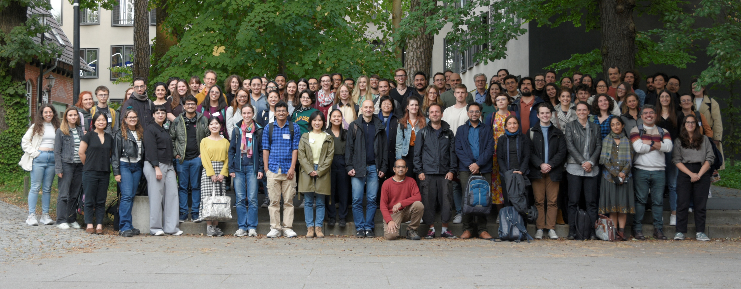


Summer School on Statistical Methods for Linguistics and Psychology
Prof. Dr. Shravan Vasishth (organizer)
Prof. Dr. Douglas Bates (speaker)
Application open until 01. April 2025

Slide 3
Reading material
Textbook
https://vasishth.github.io/Freq_CogSci/
Other sources:
https://stats.oarc.ucla.edu
https://ourcodingclub.github.io
Journal articles

Slide 4
Packages
lme4 – implementation of linear mixed models
lmerTest – p-values and degrees of freedom calculation for lmer
Emmeans – estimated marginal means, post-hoc tests
ggeffects – model-based estimates for plotting

Slide 5
Overview
Day 1
Statistics background
What is an LME?
Assumptions for LMEs
Building your own models
Day 2
Contrasts
Analysing results
Presenting and reporting results

Slide 6
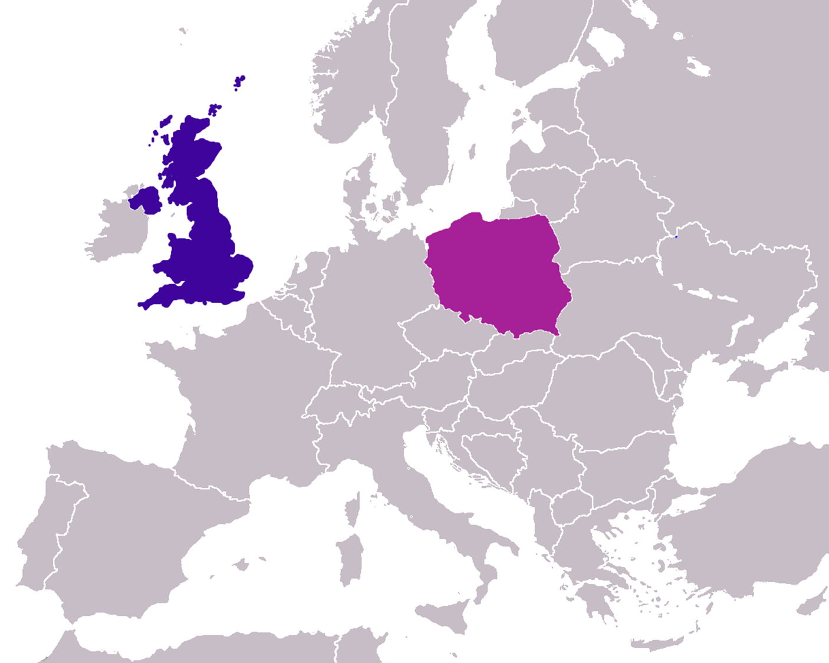
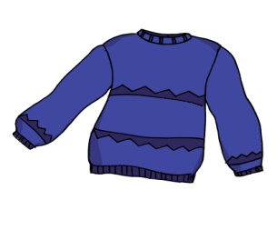
Dataset
Experimental variables
Group – Experimental vs Control
Context - UK vs PL
Trial
Subject covariates
Age
L2_AoA
Gender
SES
PL_prof
EN_prof
YoE
Item covariates
lg.freq
PL_AoA
Dependant variable
Reaction Time
1000ms
1000ms
3000ms

Slide 7
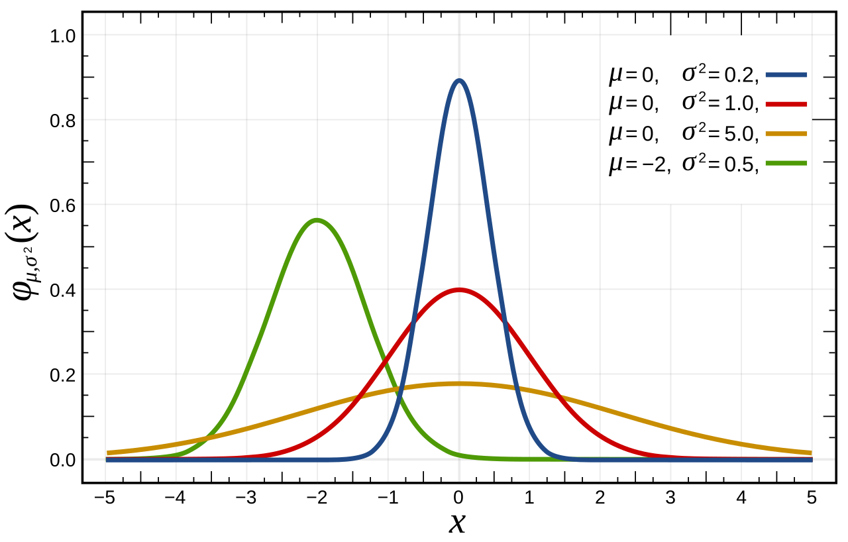
Normal distribution
Defined by
µ - mean or expectation
σ² – variance (square of standart deviation)
https://en.wikipedia.org/wiki/Normal_distribution

Slide 8
Central limit theorem
The distribution of a sample will approximate a normal distribution as the sample size becomes larger, regardless of the population's actual distribution shape.
If we repeat an experiment 1000 times, the observed effect means will be normally distributed.
From SINGLE sample with a finite number of data points we can estimate the underlying sampling distribution.

Slide 9
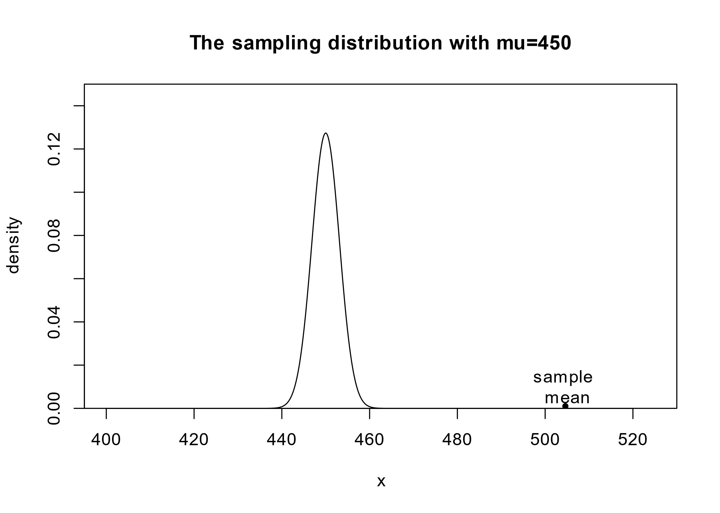
One-sample t-test
Testing experimental hypotheses:
Null hypothesis $H_{0}$: observed sample mean $\overline{y}$ is „near“ the hypothesised µ
Distance between sample mean and hypothesised mean can be written as:
$t ×SE = \overline{x} − μ$
$$T = \frac{\overline{X}− μ}{SE}$$

Slide 10
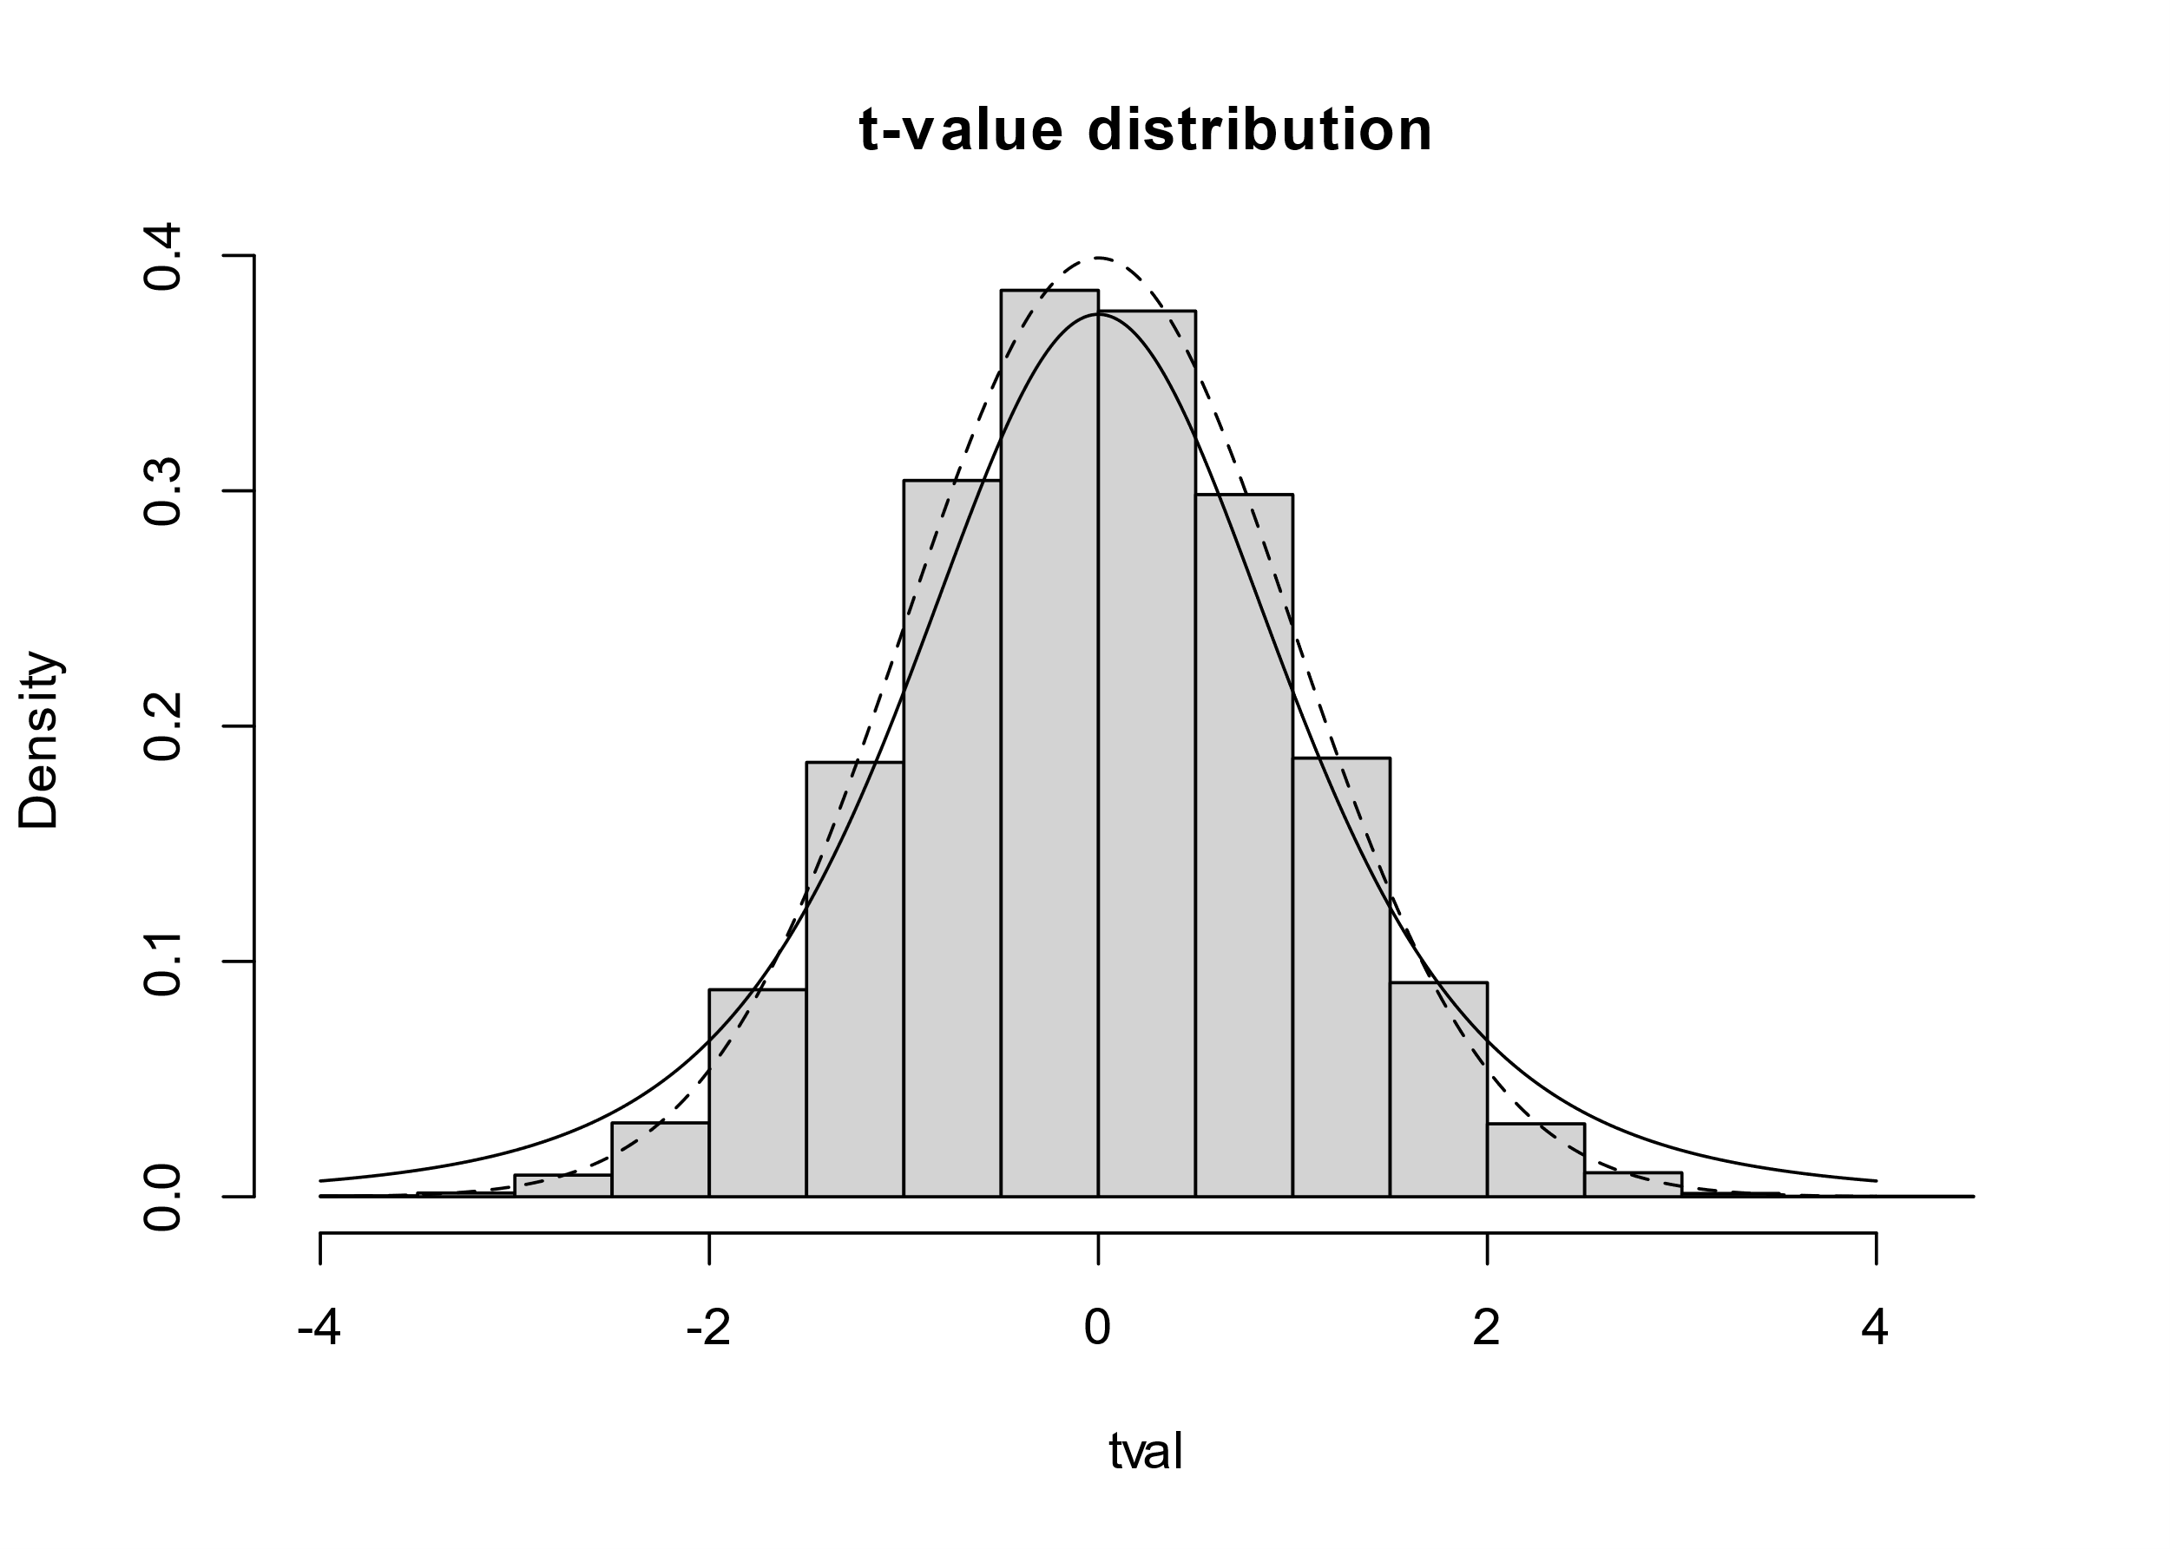
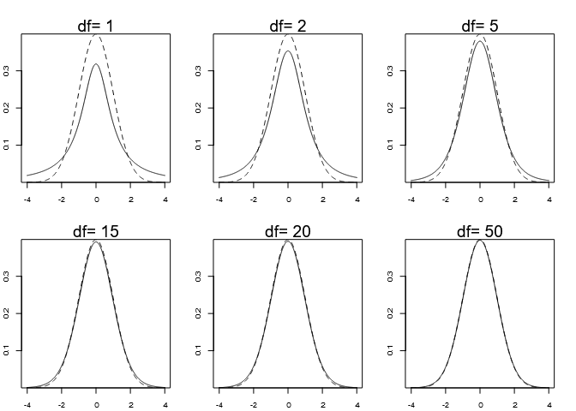
One-sample t-test
T is a random variable derived from the random variable $\overline{x}$
T-distribution approaches normal distribution, but has heavier tails (t – straight line, normal – broken line)
T-distribution depends on degrees of freedom
Higher df approach normal distribution

Slide 11
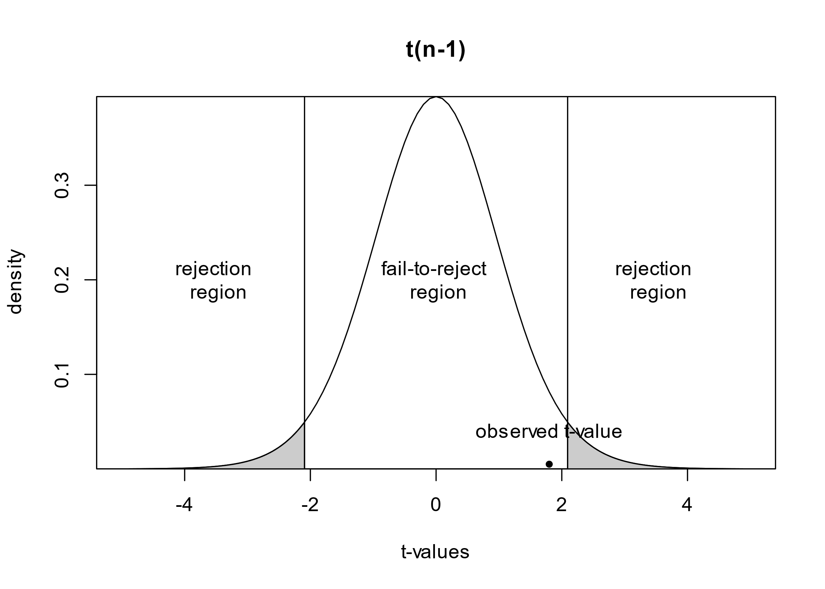
One-sample t-test
t$= \frac{\overline{y}− μ}{s/\sqrt{n}}$
$\overline{y}$ - estimate
s – standart deviation
n – sample size
„Small t-values“ confirm $H_{0}$

Slide 12
Paired t-test
$$H_{0}: μ_{UK} − μ_{PL}=0$$
Subject | meanRT
AG0911 | 810
AJ3007 | 747
AP2403 | 877
AS3008 | 1.102
AW1406 | 968
AW1912 | 1.061
BB0901 | 1.263
DS0806 | 1.098
EK1708 | 967
Subject | PL | UK
AG0911 | 708 | 913
AJ3007 | 766 | 728
AP2403 | 863 | 890
AS3008 | 1.099 | 1.104
AW1406 | 1.006 | 931
AW1912 | 1.049 | 1.074
BB0901 | 1.210 | 1.321
DS0806 | 1.081 | 1.114
EK1708 | 943 | 991
$$T = \frac{{(μ}_{UK} − μ_{PL})−0}{SE}$$
t.test(paired_PNData$PL, paired_PNData$UK, paired = TRUE)
Paired t-test
data: paired_PNData$PL and paired_PNData$UK
t = -2.4871, df = 36, p-value = 0.01765
alternative hypothesis: true mean difference is not equal to 0
95 percent confidence interval: -67.783400 -6.890745
sample estimates: mean difference -37.33707

Slide 13
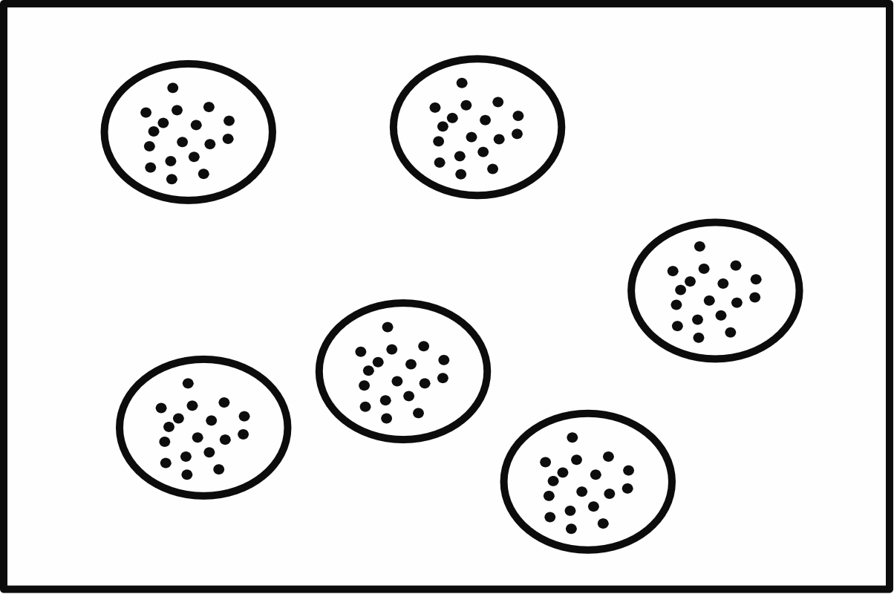
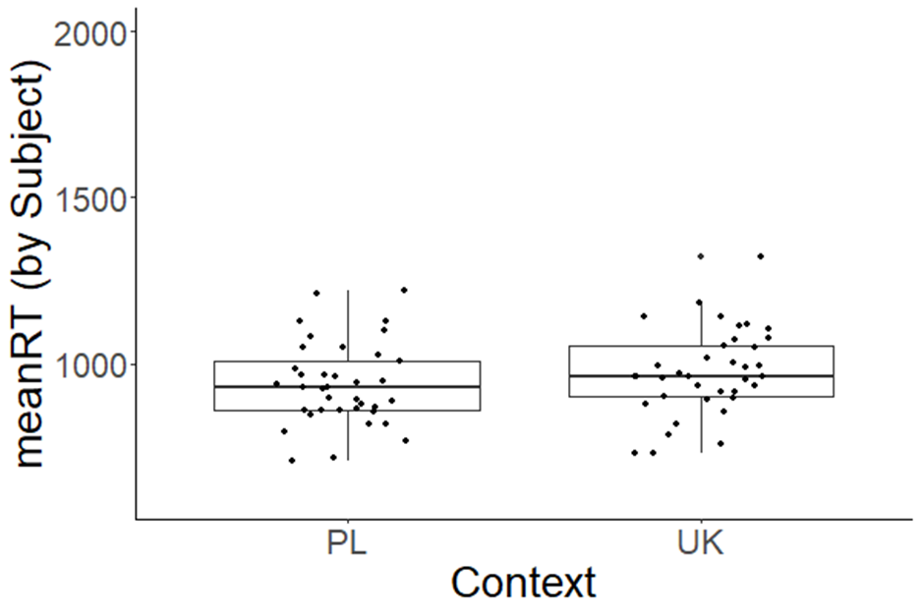
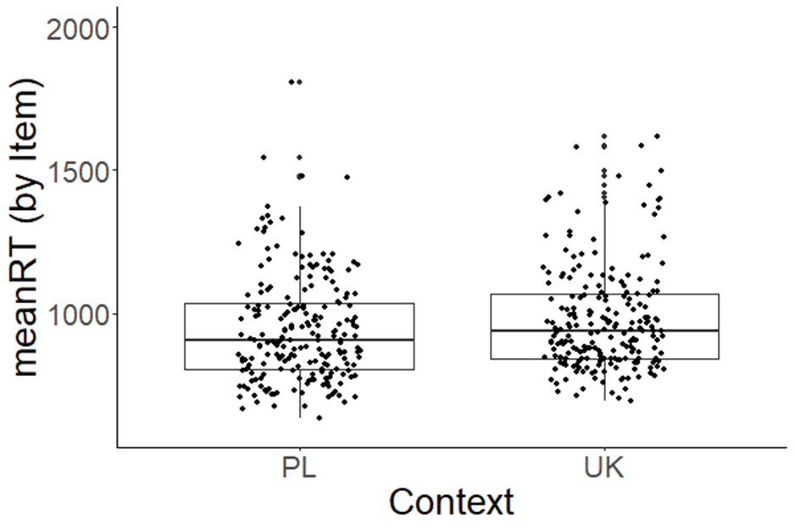
T-test assumes independence of samples
Experimental sample are often not independent (multiple trials per subject, different recording sites etc.)
You need to average over your data
Usually Subject and Items
https://stats.oarc.ucla.edu/other/mult-pkg/introduction-to-linear-mixed-models/
Subject | RT | ItemNr | Context | Trial
AG0911 | 677 | 238 | PL | 4
AG0911 | 744 | 217 | PL | 5
AG0911 | 603 | 214 | PL | 6
AG0911 | 594 | 215 | PL | 7
AG0911 | 861 | 253 | PL | 8
AG0911 | 861 | 235 | PL | 9
AG0911 | 568 | 208 | PL | 10
AG0911 | 642 | 249 | PL | 11
AG0911 | 590 | 220 | PL | 12
AG0911 | 672 | 209 | PL | 13
AG0911 | 760 | 230 | PL | 14

Slide 14
Subject and Item analysis
Both t-tests show significant differences in Context
But you lose data
Interpretation can be difficult
t.test(Context_Item_PNData$PL, Context_Item_PNData$UK, paired = TRUE)
t = -3.6664, df = 207, p-value = 0.0003127
alternative hypothesis: true mean difference is not equal to 0
95 percent confidence interval: -57.64880 -17.33075
sample estimates: mean difference
-37.48977
t.test(Context_Subject_PNData$PL, Context_Subject_PNData$UK, paired = TRUE)
t = -2.4871, df = 36, p-value = 0.01765
alternative hypothesis: true mean difference is not equal to 0
95 percent confidence interval: -67.783400 -6.890745
sample estimates: mean difference -37.33707

Slide 15
Linear mixed model as solution
The identical results can be achieved using a linear mixed model
t.test(Context_Subject_PNData$PL, Context_Subject_PNData$UK, paired = TRUE)
t = -2.4871, df = 36, p-value = 0.01765
alternative hypothesis: true mean difference is not equal to 0
95 percent confidence interval: -67.783400 -6.890745
sample estimates: mean difference -37.33707
$$T = \frac{{(μ}_{UK} − μ_{PL})−δ}{SE}$$
lmer(meanRT ~ Context + (1 | Subject), Context_Subject_PNData)
Estimate Std. Error t value
(Intercept) 936.6390 20.7199 45.2046
ContextUK 37.3370 15.0122 2.4871
$$y_{iUK}=β_{0}+u_{0i}+ε_{iUK}$$
$$y_{iPL}=β_{0}+δ+u_{0i}+ε_{iPL}$$
$$d_{i}=y_{iUK}−y_{iPL}=δ+(ε_{iUK}−ε_{iPL})$$
$β_{0}$ - average RT
$u_{0i}$- subject dependant adjustment
$ε_{iUK}$ - error/noise term
$δ$ – Context effect
$$d_{i}=y_{iUK}−y_{iPL}=δ+(ε_{iUK}−ε_{iPL})$$
$$T = \frac{(y_{iUK}−y_{iPL})−0}{SE}$$
Notes:
Minus because of sum coding

Slide 16
When to use LMEs
Continous dependet variable
Clustered data (e.g. participants, recording locations etc)
No interest in the differences between clusters
Multiple crossed or nested clusters
Flexibility for more complicated designs

Slide 17
Advantages of LME over ANOVA
Analysis of unbalanced datasets (unbalanced designs or missing values)
Modelling of correlations between observations
Allows unequal variance between groups
But:
ANOVA provides analysis of variance tables
ANOVA is computationally more efficient

